Slide 1
BUZZINGA (Business Automation Service)

Slide 2
PROBLEM STATEMENT
In the growing age of digitization especially after the pandemic, there is an ever- growing need for developing a reliable application for Business owners to manage their business.
Managing a Business is a very sensitive part and it is faced with a lot of challenges. Business Owners need to take lots of features into consideration in order to make sure that the business runs smoothly. It is not only the everyday sales, but also the customer retention, sales and stock tracking, accounts and receivables, which needs proper management. And being in charge of all of these things is definitely not easy, more so, when you are required to take care of all of these things single handedly.
An automated and intuitive management solution makes things easier in such a situation. The application should be very user-friendly. The robustness of the application is key to its success, it should not crash during peak hours.

Slide 3
PROPOSED SOLUTION
BUZZINGA aims to provide an online solution (web app) for run and manage a Business online.
It tracks all the information of Payments, Expenses ,Invoices , Sales , Employees , Customers etc.
Manage the information of Payments Shows the information and description of the Stock, Sales
All the fields such as Stock, Sales, Products are validated and does not take invalid values
It generates the invoice and also Email it to the customer.
You can also download pdf of invoice.
To increase efficiency of managing the Stock, Payments It deals with monitoring the information and transactions of Discounts.
Manage the information of Stock
Editing, adding and updating of Records is improved which results in proper resource management of Stock data.
Integration of all records of customer.

Slide 4
TECHNOLOGY STACK
Frontend Technology
Backend Technology
Others
JavaScript ES6
HTML 5
CSS 3
Bootstrap 5.0
Sass 1.50
Node.js 15.11.0
Express.js 4.17.2
EJS 3.1.6
MongoDB 5.0.8
SendGrid 5.2.3
VScode
Git and GitHub

Slide 5
EXPECTED MODULES
Authentication
Business Management
Other
Sign Up
Login
Logout
Reset Password
Email Verification
Products Management
Invoices Management
Expenses Management
Sales Management
Firm Management
Employee Management
Customer Management
Package and order management
Profile

Slide 6
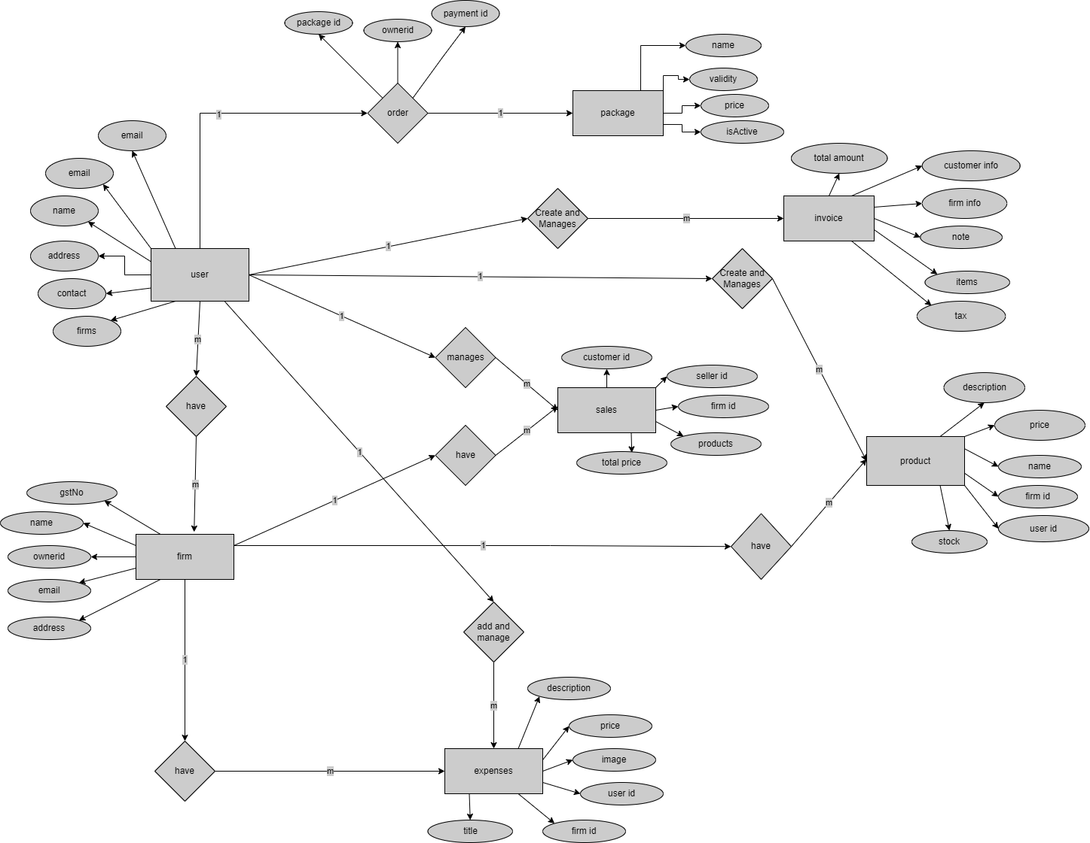
Entity Relationship Diagram

Slide 7
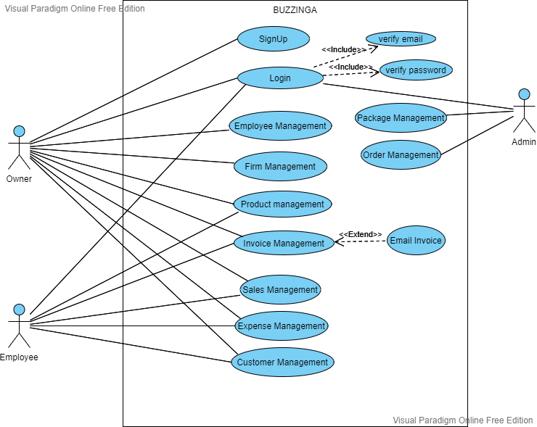
Use Case Diagram

Slide 8
CONCLUSION
A interactive web application for Business Automation.
Express.js will be used for System Development followed by MVC Architecture.
The agile methodology will be followed for the development of the project.
RazorPay Payment Gateway for capturing payments from Subscribers.
SendGird for sending Emails to Customers.

Slide 9
FUTURE SCOPE
Accounting and Taxation module can be added.
Marketing module can be added for running marketing campaigns.
Payroll module can be Added.
Mobile Wallets and Online card payments module can be embedded for receiving payments from customers.
Can make iOS and android application for easy access.

Slide 10
BIBLIOGRAPHY
https://getbootstrap.com/
https://nodejs.org/en/
https://www.npmjs.com/
https://www.geeksforgeeks.org/nodejs/
https://www.udemy.com/course/the-complete-nodejs-developer-course-2/

